Slide 1

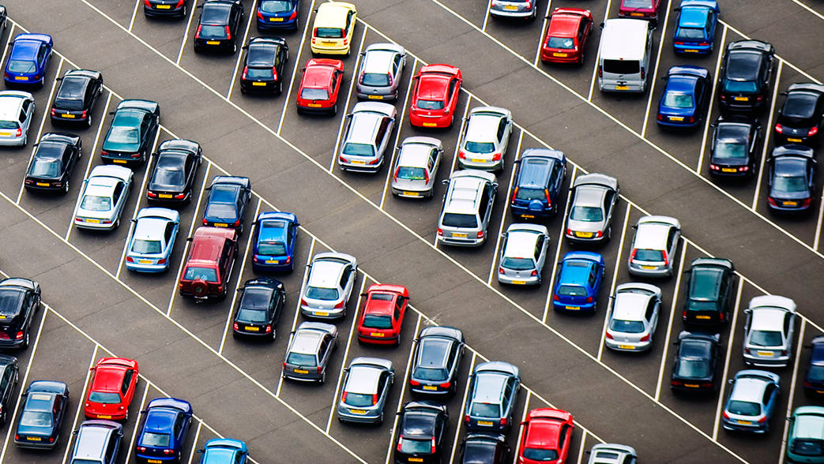


Parking Street
Know Your Parking
By:-
Team Number:- 89
Swapnil Agrawal (E19CSE233)
Tarussi Shailendra Singh (E19CSE278)
Shourya Mupparapu (E19CSE150)
Mentor :- Dr. Shakti Sharma

Slide 2

Table of Contents
Introduction
Problem Statement
Role of Each Member
Proposed System
Features
Tools and Technology
UI Designs
Flow/ER-diagrams

Slide 3
Introduction
Nowadays fast is just not enough. Every single approach that we have followed so far is being looked through a magnifying glass, on how to do it better, how to make it faster.
Parking is also one of the emerging problems. The search for a parking space is becoming more and more frustrating for people. Factors like lack of sufficient parking space and a constant increase in the number of vehicles only add to the difficulties.
Our project Parking Street, provides localities having parking spaces a platform to manage the incoming traffic in a simpler, digitized way.

Slide 4
Problem Statement
Nowadays, parking is a big issue and very less spaces are available where one can park their vehicle safely and securely and also according to the new guidelines related to parking norms comes into effect, one has to pay a heavy amount for not doing the parking correctly.
There is no user-friendly management system for the vehicles parked in the parking spaces, and also the real time availability of those spaces for the customers.
In the traditional valet parking system, we have to wait at the exit for quite a bit of time before our car arrives.

Slide 5
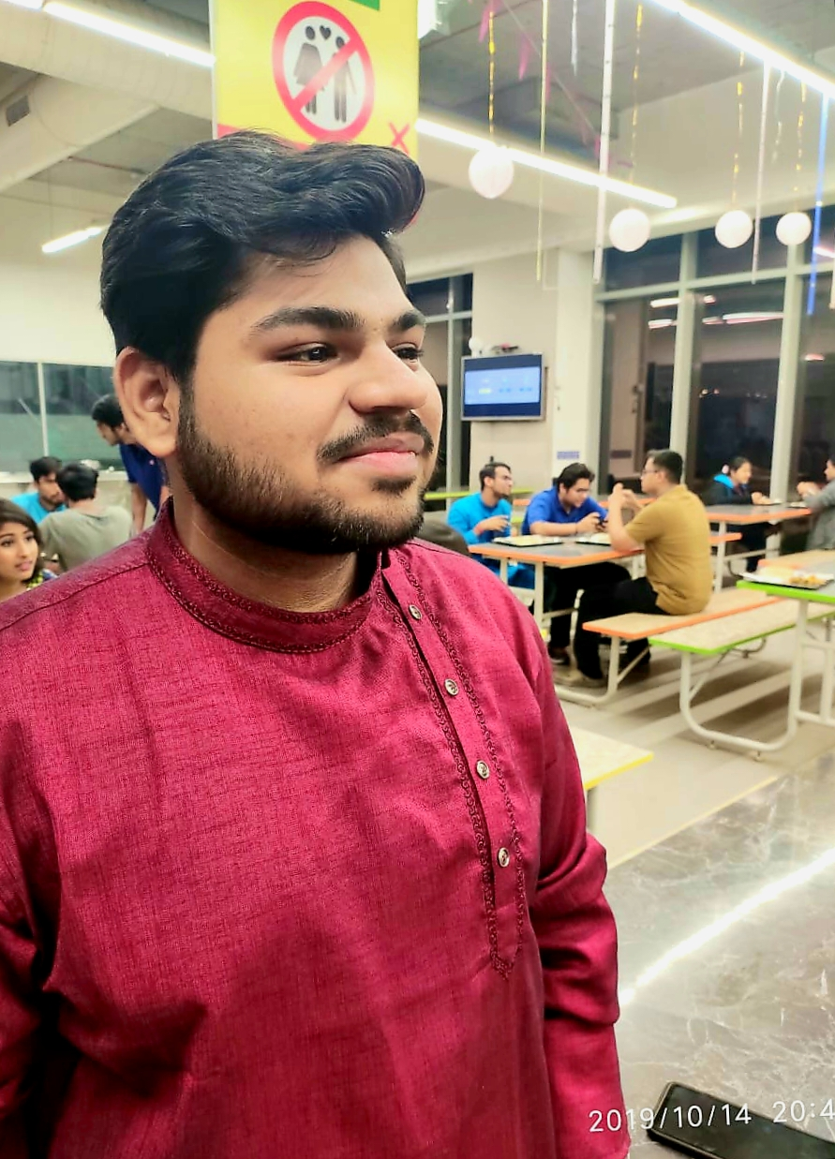


Roles Of Each Member
SWAPNIL AGRAWAL (E19CSE233)
Backend and Frontend Designer
TARUSSI SHAILENDRA SINGH (E19CSE278)
Frontend and Database Designer
SHOURYA MUPPARAPU (E19CSE150)
Backend and Database Designer

Slide 6
Proposed System
This project aims at converting the existing parking system into a smart parking system. By using the concept of real-time data acquisition, we hope to put forward a platform which would not only make it easier for the public to find a parking spot but will also allow hotels, malls, restaurants and other localities with parking spaces to manage their incoming traffic in a much more efficient way. Our platform would also provide tools to tackle the problems faced in a traditional Valet parking system.

Slide 7
Milestones We Achieved !
We started with scratch And we try to build the user-friendly UI for the potential customers to have clear views in their mind regarding their needs
Our Database team worked on what the information are being taken from the user and has to stored correctly on the database server.
Get the final layout of the parking space that the customer needs to book so that it can be shown correct data to the employee of the hotel so that he/she can arrange it correctly.
The final stage deals with the through testing of the project to get the final analytics that we can store to get parking data of the vehicles.

Slide 8







Technique Utilized

Slide 9

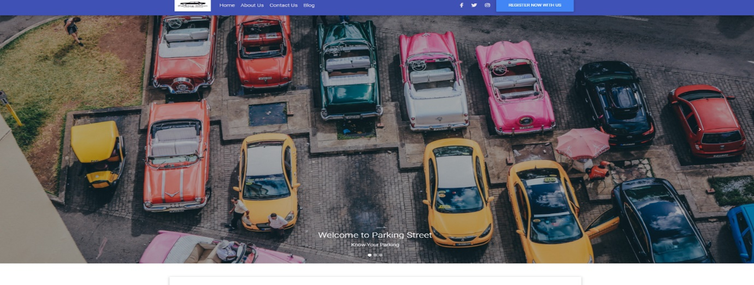
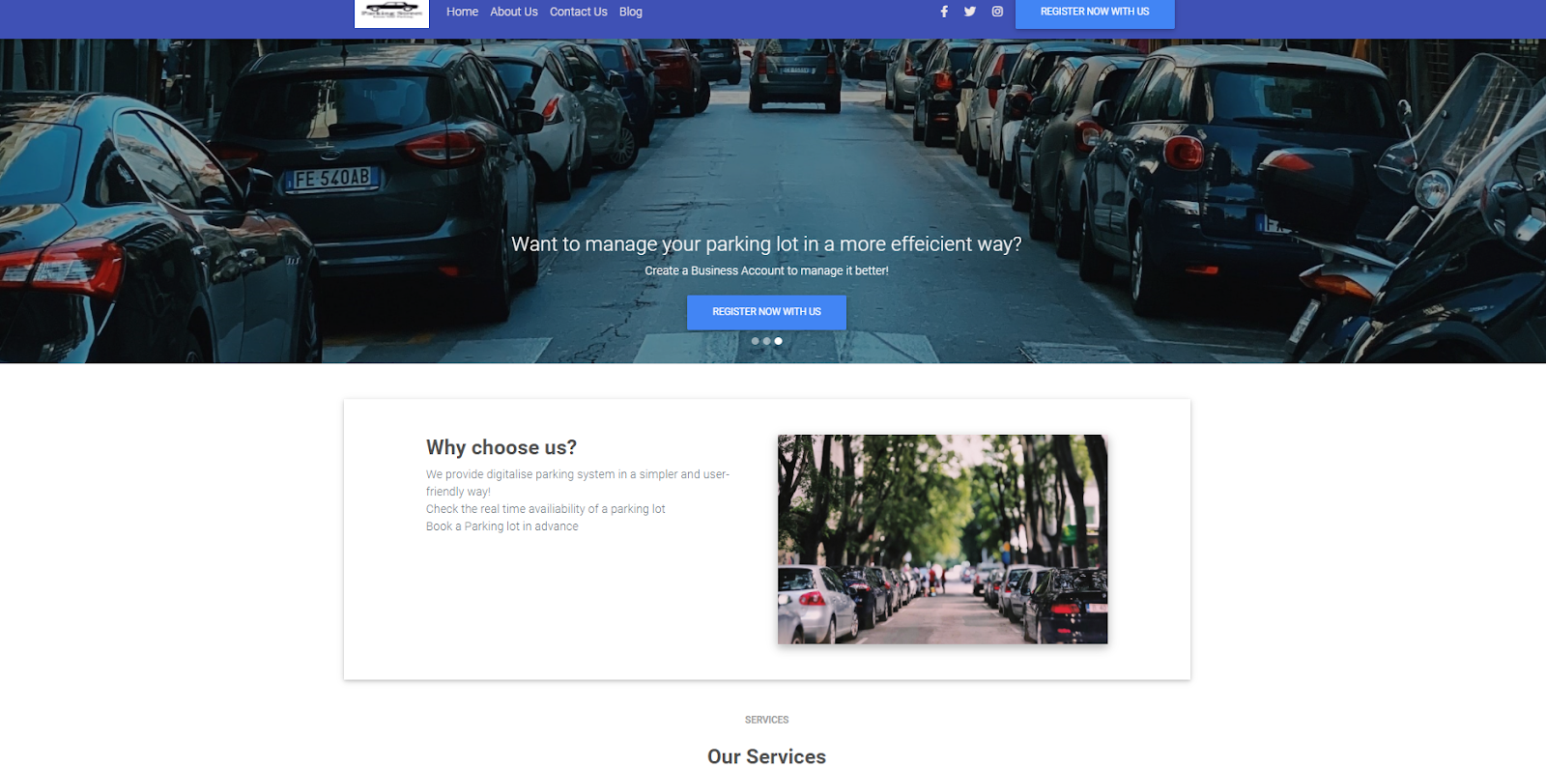
UI Designs

Slide 10
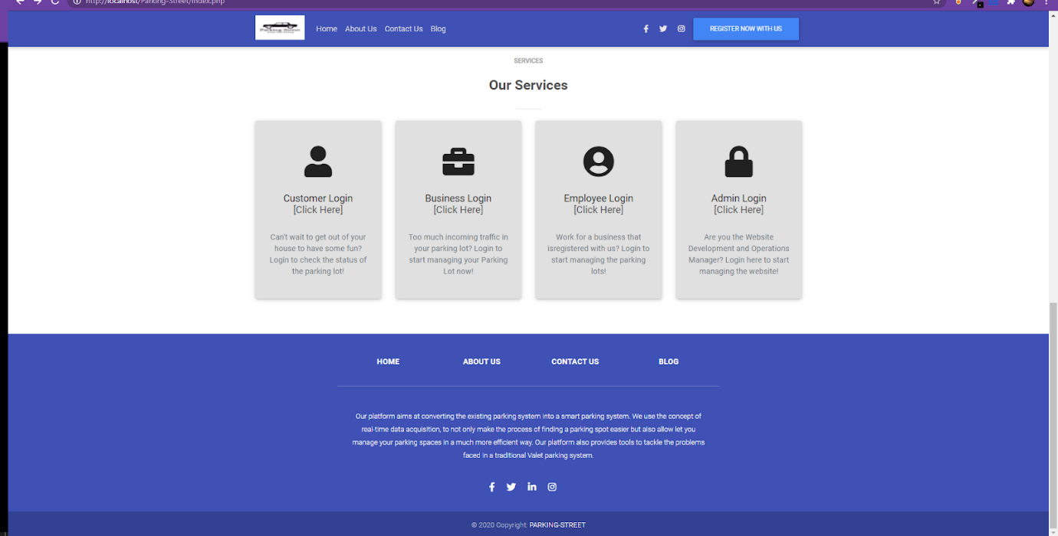
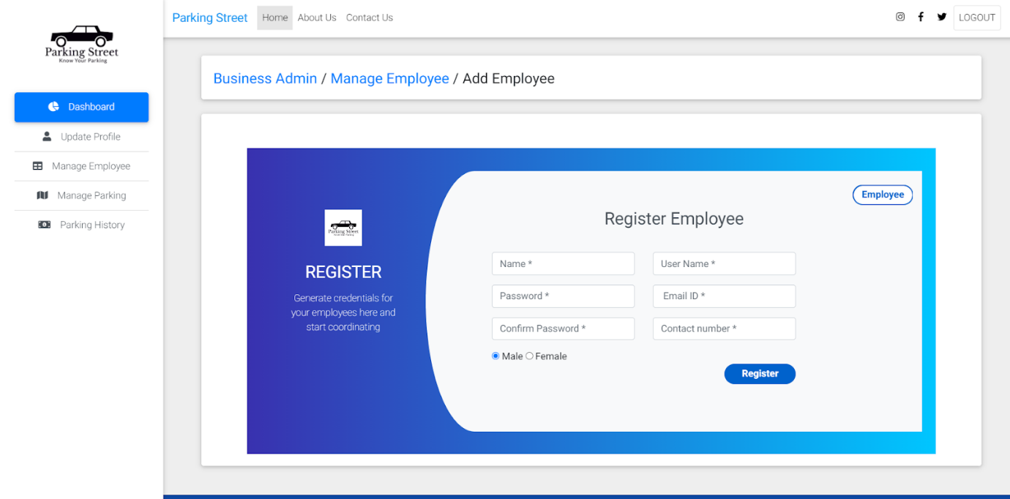

Slide 11
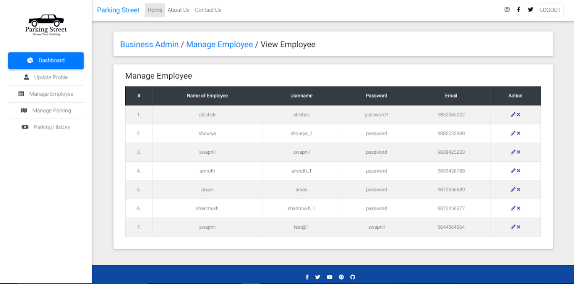
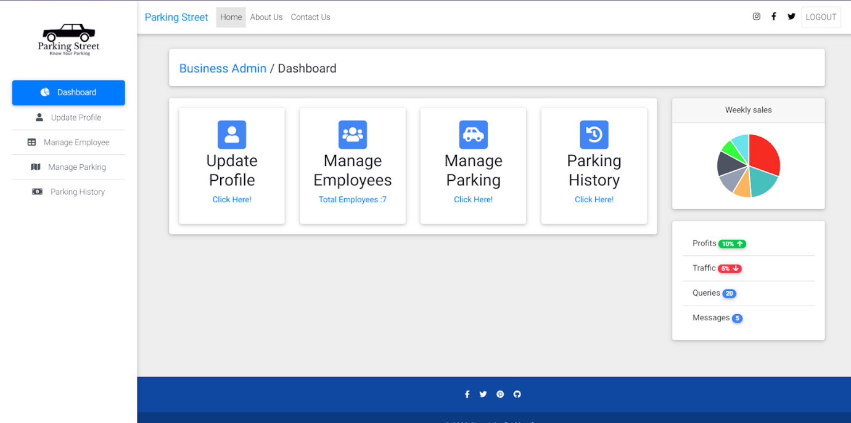
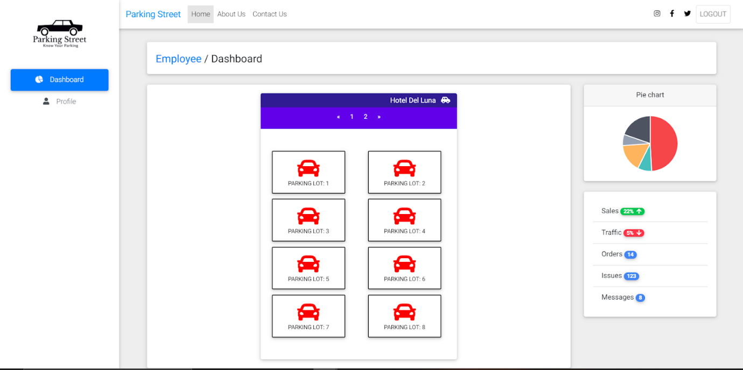

Slide 12
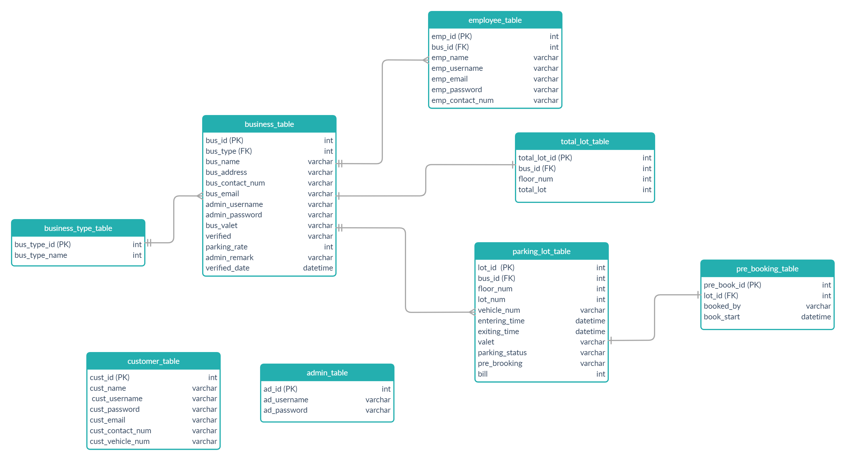
DATA ARCHITECTURE DIAGRAM

Slide 13
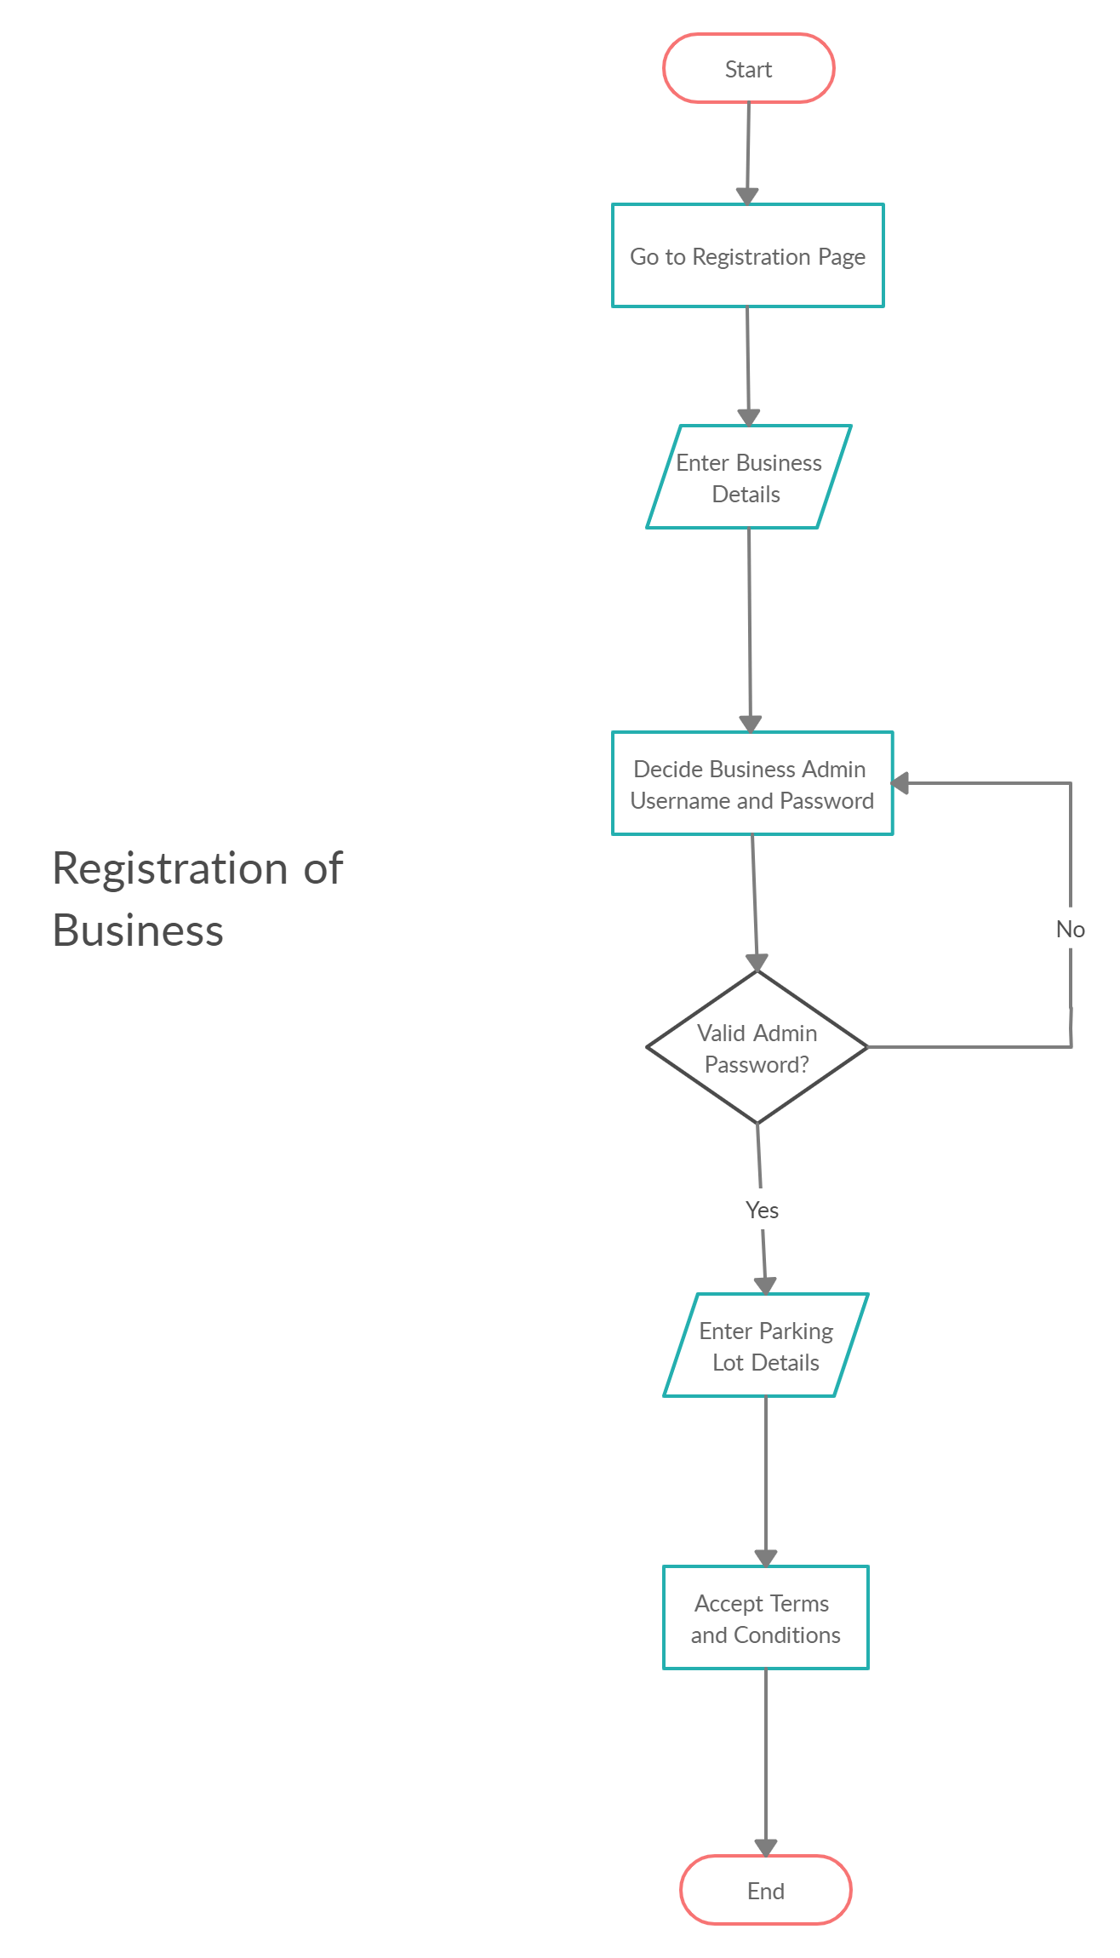
ACTIVITY DIAGRAMS

Slide 14
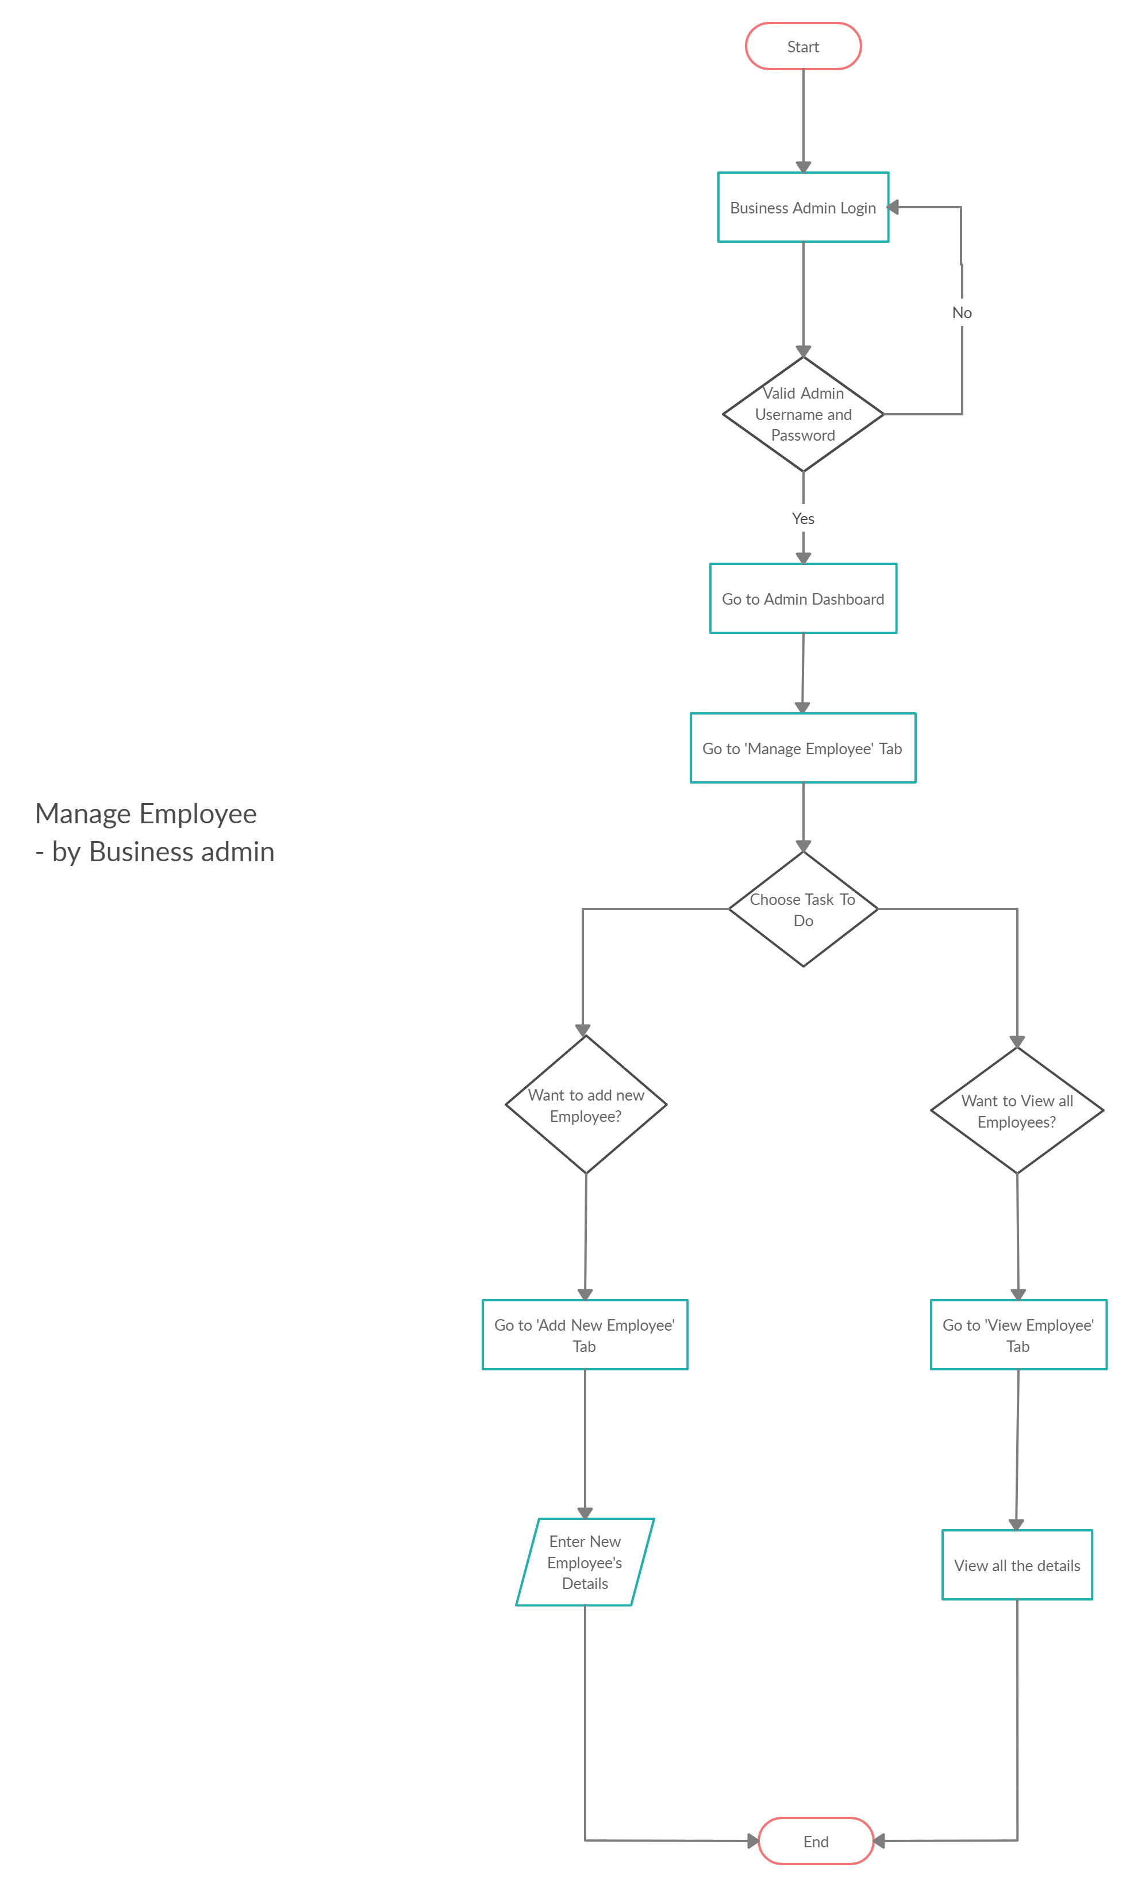
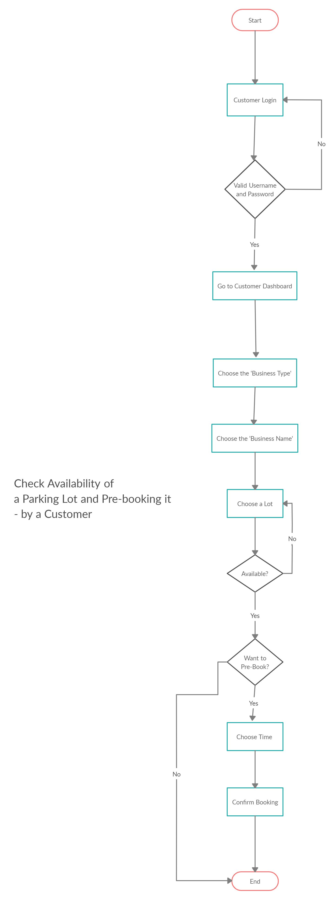

Slide 15
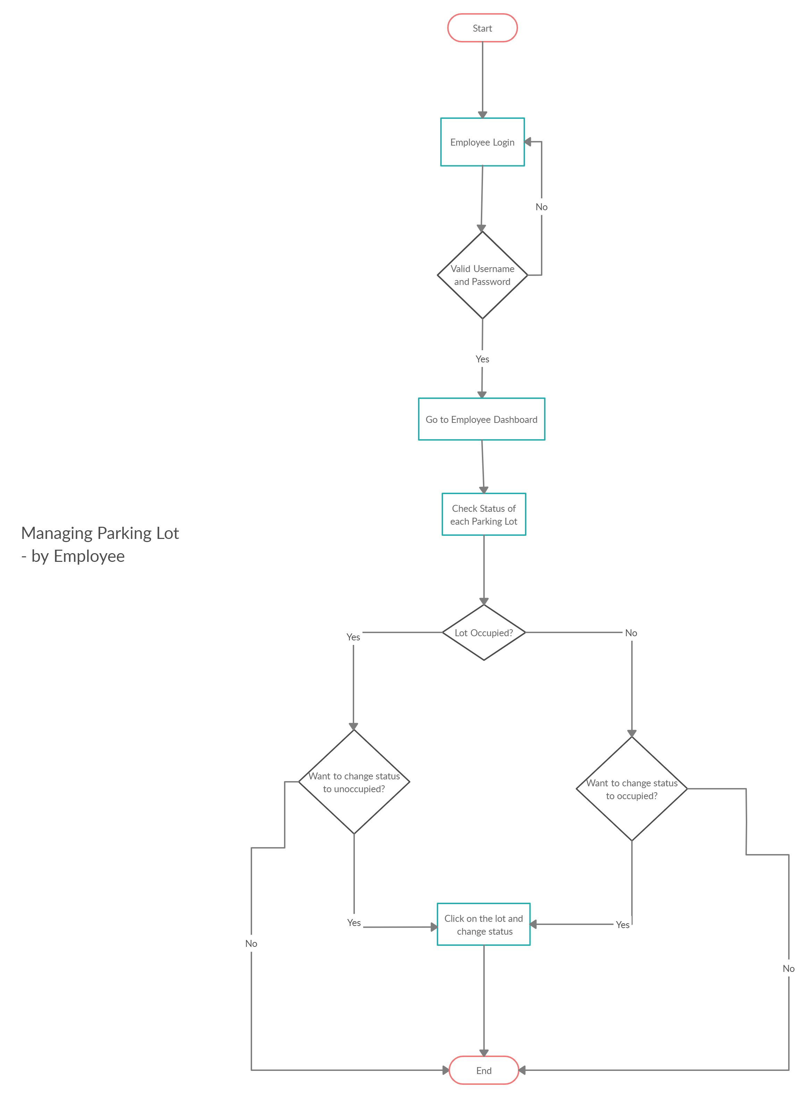
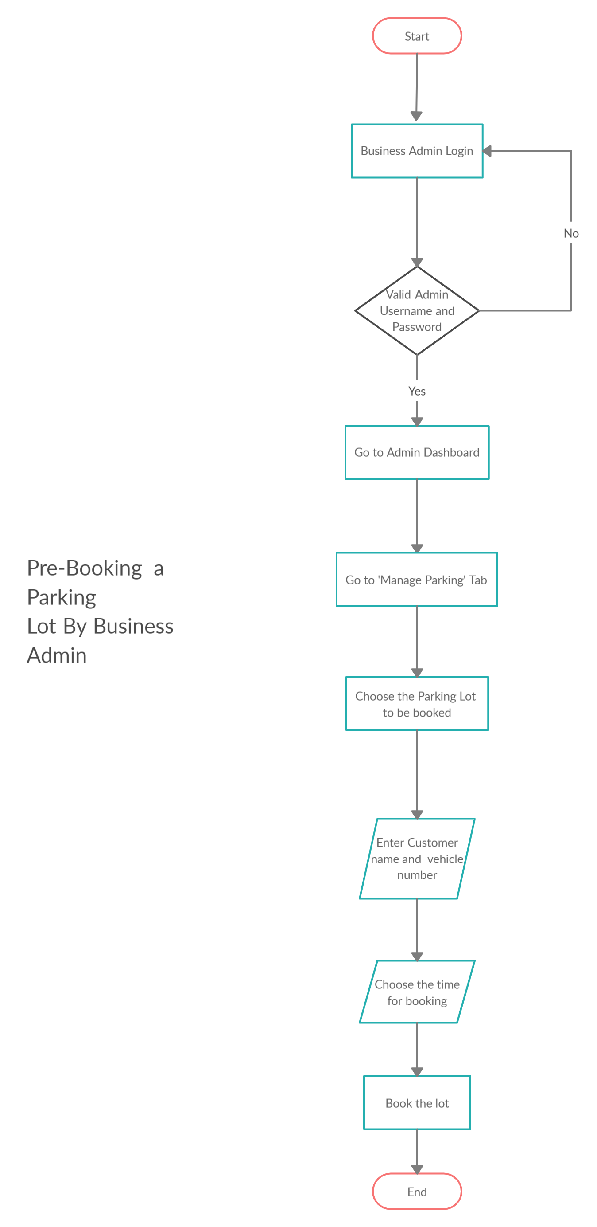

Slide 16


THANK YOU!
By:-
Swapnil Agrawal (E19CSE233)
Tarussi Shailendra Singh (E19CSE278)
Shourya Mupparapu (E19CSE150)

